Slide 1
Central Government – Policy announcement timelines
October
November
December
January
February
March
April
Autumn Budget – Phase 1 SR
Spring Budget – Phase 2 SR
Employment Rights Bill
Industrial Strategy
Data (Use and Access) Bill
8 Sector Plans
Finance Bill
English Devolution White Paper
Local Growth Plan Info
Great British Energy Bill
Get Britain Working White Paper
Trade Strategy
Passenger Railway Services Bill
Adoption of Technology advice
Product Regulation and Metrology Bill
10-yr infrastructure strategy
Procurement Act
Renters' Rights Bill
3rd Road Investment Strategy
Water (Special Measures) Bill
T.S. Railway Reform Plans
Nuclear Small Modular Reactor competition results
Local Government Reorganisation (Timing TBC)
10-yr Health Plan for NHS
Social Impact Investment Vehicle

Slide 2
Central Government – Consultations
October
November
December
January
February
March
April
24 Nov
2 Dec
4 Dec
30 Dec
Spring Budget – Phase 2 SR
Industrial Strategy
Invest 2035: Industrial Strategy
10-yr infrastructure strategy
Make Work Pay:
Collective redundancy and fire & rehire
The application of zero hours contracts measures to agency workers
Creating a modern framework for industrial relations
Make Work Pay:
Strengthening Statutory Sick Pay
Review of Legal Challenges to Nationally Significant Infrastructure Projects (NSIPs)
Employment Rights Bill: Make Work Pay

Slide 3
Kent & Medway Economic Framework – Activities underway
Enabling innovative, productive & creative businesses
Tudor Price & Steve Samson
Widening opportunities
& unlocking talent
Simon Cook & Dan Ratcliffe
Securing resilient infrastructure for planned, sustainable growth
Vince Lucas &
Tom Marchant
Placing economic opportunity at the centre of community wellbeing & prosperity
Nick Fenton &
Andrew Osborne
Creating diverse, distinctive
and vibrant places
Miranda Chapman &
Adam Bryan
Innovation Partnership
Connect to Work
Lower Thames Crossing
Eurostar
Regional Energy Strategic Plan
Strategic Partnership for Health & Economy
Supporting creative and cultural economy
Grow In Kent Brand
Angel Investment
Actions for BAB to consider please
Thoughts on local innovation clusters
Lobby government & MPs on LTC & Eurostar
Add to LTC support map of businesses: Support map for the Lower Thames Crossing - National Highways
Case Studies on best practice for health & work strategy

Slide 4
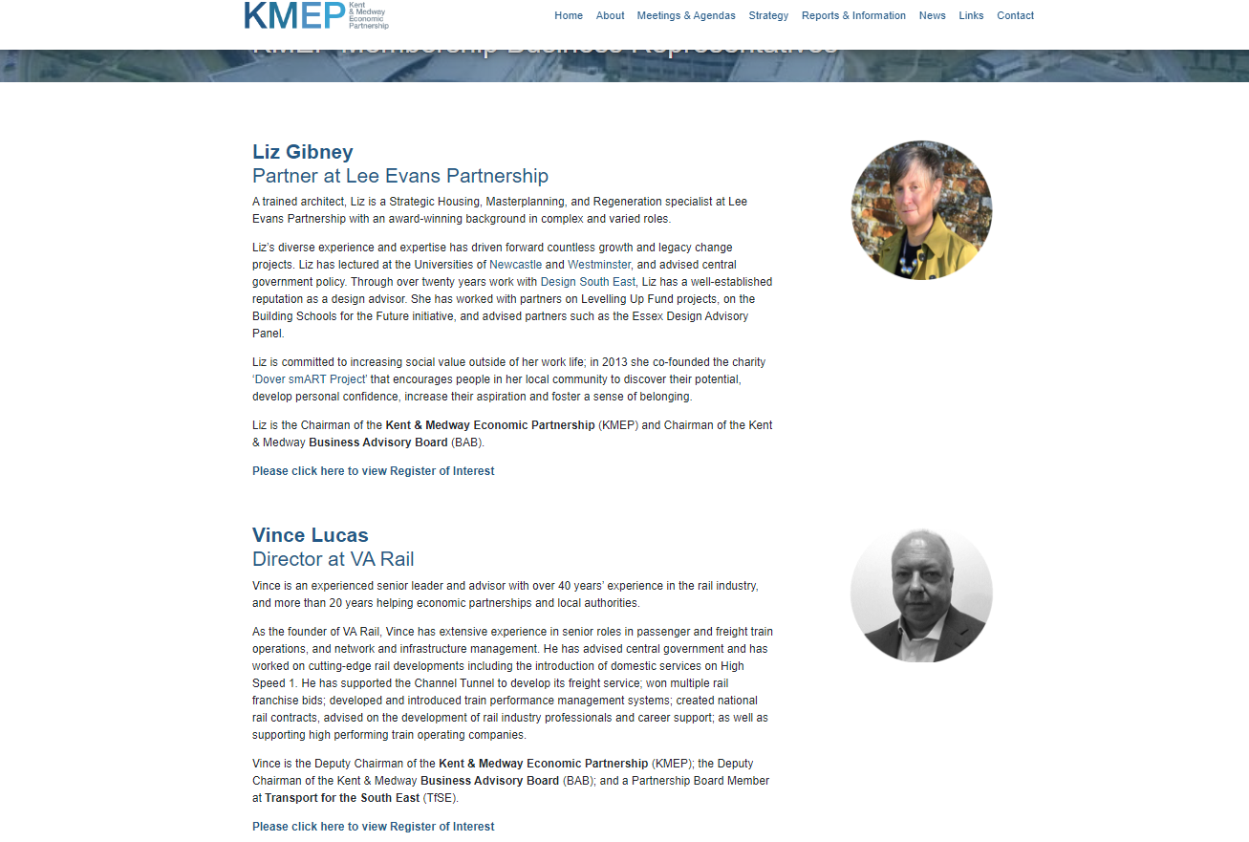
KMEP Website Refresh – BAB Member Online Bio www.kmep.org.uk
Please could you provide the following:
A high resolution professional headshot – preferably in circular format
A short biography (including your membership to any other Boards) – 250 Words Max
By 22 November emma.watson@kent.gov.uk

