Slide 1
Work and health

Slide 2
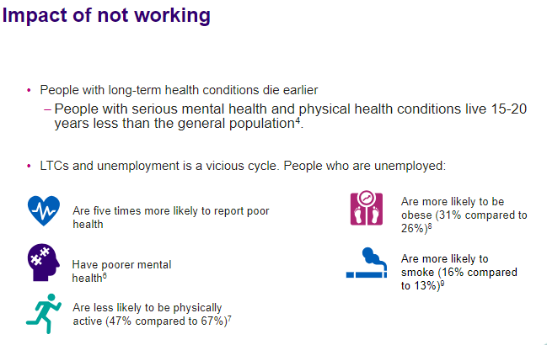
What effects our health and wellbeing?

Slide 3
An integrated work and health strategy for Kent and Medway will…
Establish an ICS-wide Work and Health Partnership, which should include:
  Local Authorities,
  GPs and the primary care system,
  wider NHS, DWP/Jobcentre Plus,
  voluntary and community organisations and
  employers.​
Map existing work and health provision gaps and assets, and opportunities for greater integration.​
Develop a service integration Strategy and make links with other opportunities, including for example levelling up.

Slide 4
Questions?

Slide 5
What are the key challenges?
Regarding the ability to better meet the needs of the people with LTHC and disabilities that you work with, to start stay and succeed in work. What are the main challenges?

Slide 6
What would they like to see happen?
Are there particular programmes or pathways that are missing and should be developed, or are there existing services and programmes that could be made to work better through new kinds of integration and collaboration?

