Slide 1
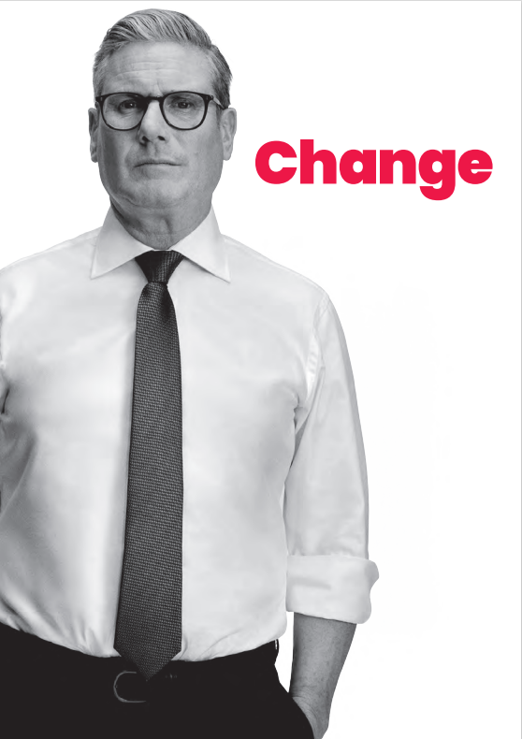
The new Government’s growth agenda
Too many decisions are taken in Westminster, not by local leaders.
Deepened devolution settlements for existing Combined Authorities. Elsewhere, local authorities encouraged to come together to take on new powers.
New powers to local areas for transport, adult education, skills, housing, planning, and employment support.
A new statutory requirement for Local Growth Plans.
Local leaders to work with major employers, universities, colleges, and industry bodies (i.e. KMEP partners) to produce long-term plans identifying growth sectors, programmes and infrastructure needed to thrive. Plans to align with national industrial strategy.
Councils given multi-year funding settlements. No more competitive bidding.
Notes:
As Douglas and Jo have stated, the importance of KMEP is that it brings together individuals from business, local councils, universities and further education colleges to work in partnership.
By working together and talking amongst the partners, we can collectively acquire an in-depth knowledge of the economic opportunities and challenges facing Kent and Medway. This knowledge can then form the basis of our plans and strategies, such as the Enterprise & Productivity Strategy for Kent & Medway. KMEP is the forum in which to strategically plan how best to exploit the economic opportunities available.
A key function of KMEP is to act as an informed voice for our area in SELEP’s funding discussions. With SELEP covering such a vast geographical area, which stretches from Stansted Airport and Colchester in the north to Dungeness and Newhaven in the South, it is virtually impossible for one SELEP board member to have intimate knowledge of the economic priorities of each town and city. It is therefore absolutely essential that the local boards, such as KMEP, have a strong voice is the allocation of funding.

Slide 2
Messages to send
Manifesto Commitment | Aspects to include in a letter?
We need a more active, smarter government that works in partnership with business, trade unions, local leaders, and devolved governments. | Introduce KMEP
Labour will introduce a new industrial strategy. Our approach will be long-term, mission-driven, and focused on the future. A new statutory requirement for Local Growth Plans | Introduce the Kent and Medway Economic Framework Express willingness to create new local Industrial Strategy and pilot initiatives Interest in knowing more about the devolution agenda
Labour will take a sectoral approach and be clear-eyed about where the UK enjoys advantages over other countries. | Set out Kent and Medway Sectorial Strengths, including in: Life-sciences Agri-tech and food production Creative and Digital Transport and Logistics Construction Manufacturing (?)
Labour will get Britain building again, creating jobs across England, with 1.5 million new homes over the next parliament. We will implement solutions to unlock the building of homes affected by nutrient neutrality without weakening environmental protections. | Set out Nutrient Neutrality challenge in Kent and Medway
Notes:
The Kent & Medway Economic Framework was agreed and published in early 2024.
The overarching objective is to develop an economy that is more “productive, sustainable and inclusive”.
Officers have begun initial work on an Implementation Plan – which sets out activities and outcomes under the five ambition areas.
The five ambitions:
Enable innovative, productive and creative businesses
Widen opportunities and unlock talent
Secure resilient infrastructure for planned, sustainable growth
Place economic opportunity at the centre of community wellbeing and prosperity
Create diverse, distinctive and vibrant places
Working with the public and private sector Thematic Leads, an early draft version of the plan has been developed.
The current iteration of the plan primarily focuses on enabling activity and “quick wins”. The intention is that the Implementation Plan will be an evolving document and further feedback from all partners is appreciated.
In parallel to this, it is our intention to create a project pipeline that can be responsive to any future funding opportunities.

Slide 3
Messages to send
Manifesto Commitment | Aspects to include in a letter?
With Labour, Britain will stay outside of the EU. But to seize the opportunities ahead, we must make Brexit work. We will reset the relationship and seek to deepen ties with our European friends, neighbours and allies. Labour’s National Wealth Fund will directly invest in ports - £1.8 billion Labour will also develop a long-term strategy for transport, ensuring transport infrastructure can be delivered efficiently and on time. | Emphasis our role as International Gateway to the EU, and need to invest in international connectivity infrastructure, including Lower Thames Crossing; Operation Brock & Entry-Exit System Brenley Corner, A2 Dover Access, Dover TAP, A229 & other key junctions Dover’s Levelling Up Fund Round 2 investment at the Port of Dover Eurostar stopping services
The UK has stark health inequalities. As part of our health mission, Labour will tackle the social determinants of health, halving the gap in healthy life expectancy between the richest and poorest regions in England. | Comment on our position in the South East. Reference to our current work on setting up the Strategic Partnership for Health and the Economy
The current higher education funding settlement does not work for the taxpayer, universities, staff, or students. Labour will act to create a secure future for higher education and the opportunities it creates across the UK. | Sustainability of universities and breadth of course provision Desire to grow R&D and university spin-offs – creation of innovation partnership?
Local government is facing acute financial challenges. Labour government will give councils multiyear funding settlements and end wasteful competitive bidding. | Set out local context – using highway network as an example
Notes:
The Kent & Medway Economic Framework was agreed and published in early 2024.
The overarching objective is to develop an economy that is more “productive, sustainable and inclusive”.
Officers have begun initial work on an Implementation Plan – which sets out activities and outcomes under the five ambition areas.
The five ambitions:
Enable innovative, productive and creative businesses
Widen opportunities and unlock talent
Secure resilient infrastructure for planned, sustainable growth
Place economic opportunity at the centre of community wellbeing and prosperity
Create diverse, distinctive and vibrant places
Working with the public and private sector Thematic Leads, an early draft version of the plan has been developed.
The current iteration of the plan primarily focuses on enabling activity and “quick wins”. The intention is that the Implementation Plan will be an evolving document and further feedback from all partners is appreciated.
In parallel to this, it is our intention to create a project pipeline that can be responsive to any future funding opportunities.

Slide 4
Messages to send
Manifesto Commitment | Aspects to include in a letter?
We will set a target for half of all food purchased across the public sector to be locally produced or certified to higher environmental standards. We will introduce a land-use framework and make environment land management schemes work for farmers and nature. We will reform the points-based immigration system. | Food security, Seasonal Agricultural Workers, & planning reform Set out Kent & Medway as the Garden of England
Labour will create a flexible Growth and Skills Levy, with Skills England consulting on eligible courses to ensure qualifications offer value for money. We will bring Jobcentre Plus and the National Careers Service together to provide a national jobs and careers service. Establish Skills England to bring together business, training providers and unions with national and local government. | Enthusiasm to be involved in this conversation
Chairman’s Proposal:
Invite Ministers and Local MPs to Growth Conversation with KMEP in September
Notes:
The Kent & Medway Economic Framework was agreed and published in early 2024.
The overarching objective is to develop an economy that is more “productive, sustainable and inclusive”.
Officers have begun initial work on an Implementation Plan – which sets out activities and outcomes under the five ambition areas.
The five ambitions:
Enable innovative, productive and creative businesses
Widen opportunities and unlock talent
Secure resilient infrastructure for planned, sustainable growth
Place economic opportunity at the centre of community wellbeing and prosperity
Create diverse, distinctive and vibrant places
Working with the public and private sector Thematic Leads, an early draft version of the plan has been developed.
The current iteration of the plan primarily focuses on enabling activity and “quick wins”. The intention is that the Implementation Plan will be an evolving document and further feedback from all partners is appreciated.
In parallel to this, it is our intention to create a project pipeline that can be responsive to any future funding opportunities.

