Slide 1
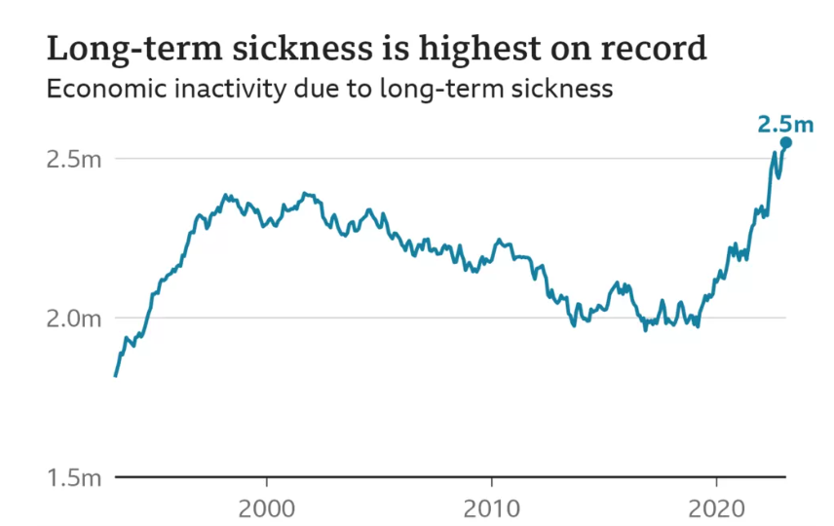

Slide 2
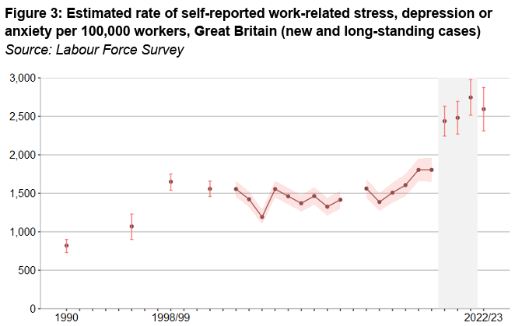
Mental health conditions
Most reported health condition in 2023 was depression, bad nerves, or anxiety (5 million).
Increasing the most.
Populations affected:
  34% of people aged 18-24 taking time off work due to stress equating to 45,500 people in Kent and Medway¹¹.
  People in more deprived areas are more likely to be affected¹².
  1 in 10 women leave work due to menopause symptoms.¹⁴

Slide 3

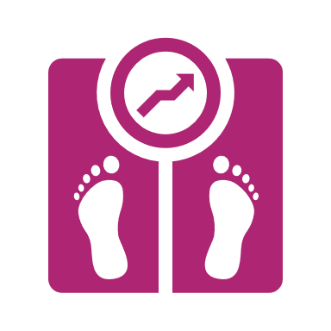



Impact of not working
People with long-term health conditions die earlier
  People with serious mental health and physical health conditions live 15-20 years less than the general population⁴.
LTCs and unemployment is a vicious cycle. People who are unemployed:
Are more likely to be obese (31% compared to 26%)⁸
Are five times more likely to report poor health⁵
Are more likely to smoke (16% compared to 13%)⁹
Have poorer mental health⁶
Are less likely to be physically active (47% compared to 67%)⁷

Slide 4
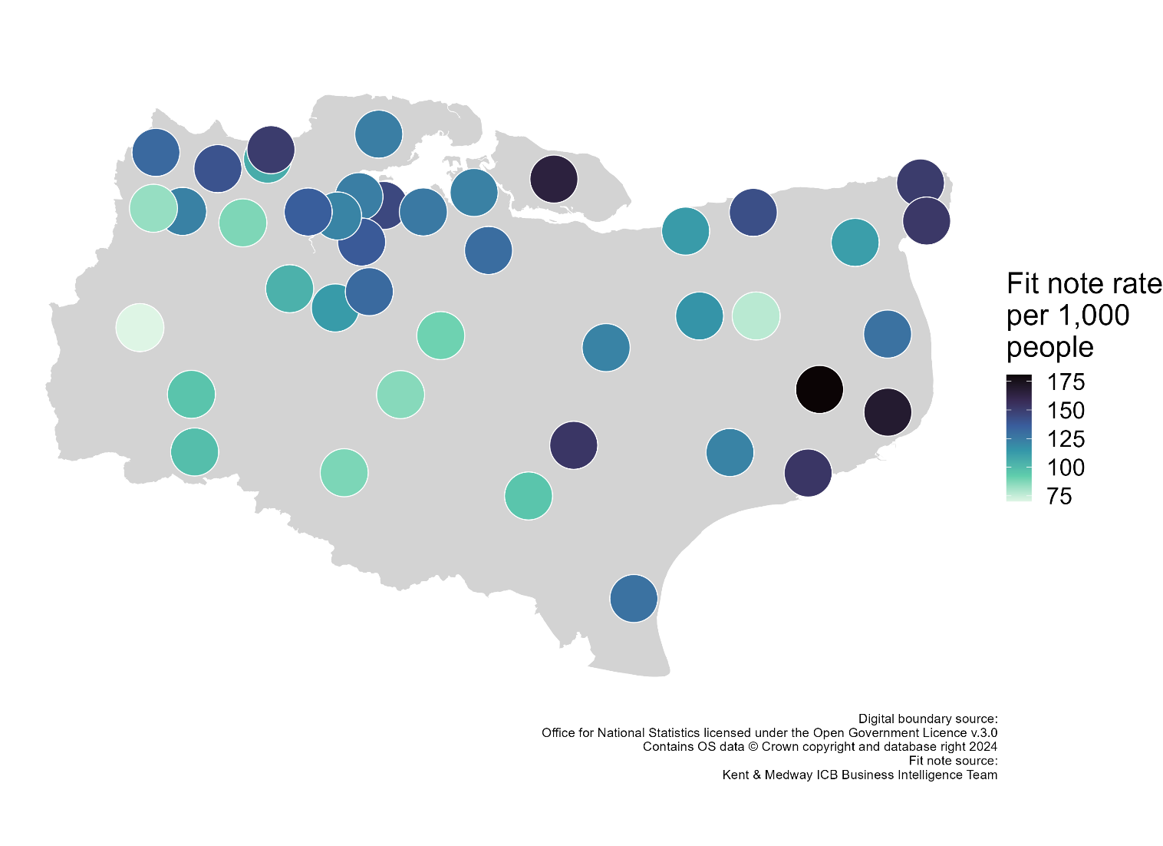
Primary Care Networks with most Fit Notes
Highest rate of Fit Notes in:
Dover
Folkestone
Sheppey
Ashford
Ramsgate
Margate
Gravesend
Medway

Slide 5
KMEP
Integrated Care Partnership (ICP)
Strategic Partnership for Health and the Economy
Produce a Health and Work Strategy focussed on economically inactive people with physical/mental health conditions:
Start work
Stay in work
Succeed in work

Slide 6
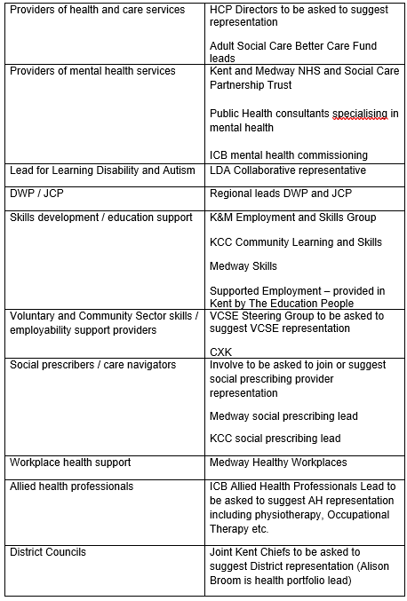
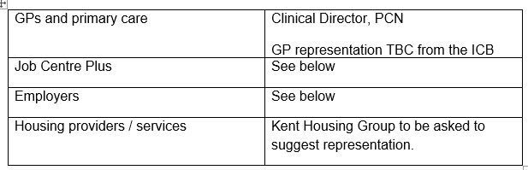
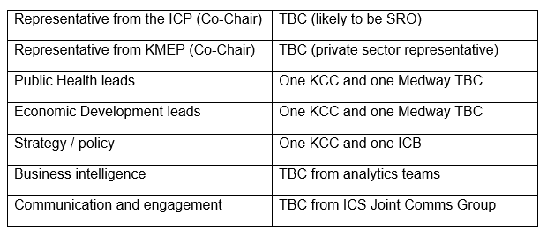
Draft Membership of new Strategic Partnership
Referral Points
Providers of support
Employers
Officer support

Slide 7
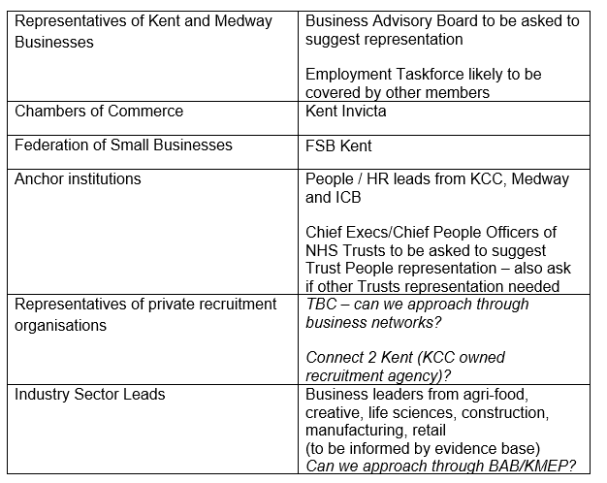
Employers – Please provide thoughts and volunteer

