Slide 1
KMEP Workstream / Kent & Medway Economic Framework Link | Kent & Medway Economic Indicators
Ambition 1 – Enable innovative, productive and creative businesses | GVA ; Number of Enterprises; Enterprise Size; Number of Exporting Businesses; Business Births and Deaths
Ambition 2 – Widening opportunities and unlocking talent | Qualifications of population aged 16-64; Number of Apprenticeship Starts in Kent and Medway; Number of Apprenticeship achievements in Kent and Medway; 16 –18 Destination Measures; Higher Education starters, graduate retention, graduates into local jobs (cost for data); Potential to use Burning Glass/ EMSI (data at cost)
Ambition 3 – Securing resilient infrastructure for planned, sustainable growth | Broadband Availability; Business Affected by increased Energy Prices; Number of Importing Businesses; Publicly Available EV Charging Places; Homeworking/ Hybrid Working; Potential to add Carbon Emissions; Potential to add Port Passenger Data
Ambition 4 – Placing economic opportunity at the centre of community wellbeing and prosperity | Unemployment / Employment Rates; Economic (in)activity data; Employment Structure (sectors); Self Employed data; Earnings,
Ambition 5 – Creating diverse, distinctive and vibrant places | Sector data regarding enterprise numbers; Potential for Town Centre footfall data (at cost)
Date of Last Update: 29 Nov 2024 | November Updates: Vulnerability Index; Number of Enterprises in Kent and Medway, updated for 2024; Size of Enterprises for Kent and Medway, updated for 2024; Claimant Count Unemployment by age, updated to October 2024.

Slide 2
KMEF Ambition: Enable innovative, productive and creative businesses Vulnerability Index
Note: A red rating indicates a greater vulnerability compared to other Kent & Medway local authorities Blank cell indicates data is missing or unavailable – last updated November 2024
Industry Sectors selected to generate score: Agriculture, forestry & fishing (A); Mining, quarrying & utilities (B,D and E); Manufacturing ©; Construction (F); Motor trades (Part G); Wholesale (Part G); Retail (Part G); Transport & storage (inc postal) (H); Accommodation & food services (I); Information & communication (J); Financial & insurance (K); Property (L); Professional, scientific & technical (M); Business administration & support (N); Public administration & defense (O); Education (P); Health (Q); Arts, entertainment, recreation & other services (R,S,T and U)
Note: A red rating indicates a greater vulnerability compared to other Kent & Medway local authorities
Blank cell indicates data is missing or unavailable
 | Economically Active | Employment rate | Self employment | No qualifications | Business births to deaths | Employee job change (all industries) | % Employee jobs in vulnerable sectors | % Vulnerable sector enterprises | Annual Average Claimant Count unemployed | Universal Credit claimants | Overall Score
Ashford | 0.12 | 0.09 | 1.61 | 2.25 | 0.93 | -0.84 | -0.16 | 1.92 | -0.13 | -0.04 | 5.76
Canterbury | 1.92 | 1.40 | 2.00 | 0.39 | -0.42 | -0.10 | 0.22 | -2.13 | -0.13 | -0.23 | 2.92
Dartford | -0.68 | -0.79 | -1.36 |  | 0.83 | -1.22 | 1.03 | -1.73 | -0.35 | -0.25 | -4.52
Dover | 1.05 | 0.78 | 1.13 | 0.35 | 0.10 | -0.87 | -0.29 | -1.05 | 0.39 | 0.76 | 2.35
Folkestone and Hythe | -1.00 | -0.90 | 0.28 | -0.11 | 0.14 | -0.04 | -1.06 | -1.05 | 0.69 | 0.46 | -2.59
Gravesham | -0.94 | -0.88 | -1.72 | 0.59 | -0.98 | 0.12 | 1.20 | -0.96 | 0.54 | 0.67 | -2.38
Maidstone | -1.39 | -1.03 | -0.26 |  | 0.32 | 0.50 | 1.18 | -0.47 | -0.35 | -0.36 | -1.86
Sevenoaks | 0.71 | 0.57 | 2.92 | -0.91 | 0.07 | 0.34 | 0.26 | 0.04 | -0.95 | -1.18 | 1.89
Swale | -0.86 | -0.79 | 1.05 | 0.79 | 0.05 | 0.06 | -1.59 | 0.04 | 0.32 | 0.65 | -0.29
Thanet | -0.68 | 0.29 | 1.69 | 1.15 | -1.26 | 0.22 | -0.87 | 0.94 | 1.95 | 2.14 | 5.58
Tonbridge and Malling | 0.81 | 0.28 | -0.41 | -0.48 | 0.61 | -0.87 | -1.56 | 0.72 | -0.95 | -0.95 | -2.80
Tunbridge Wells | 0.67 | 1.51 | 1.34 | -0.21 | 0.28 | 0.05 | -0.75 | 0.71 | -0.72 | -0.91 | 1.97
Medway | -1.02 | -0.81 | -0.34 | -0.08 | 0.89 | 0.20 | -1.00 | -0.87 | 0.46 | 0.58 | -1.99
Source: Kent Analytics, Kent County Council

Slide 3
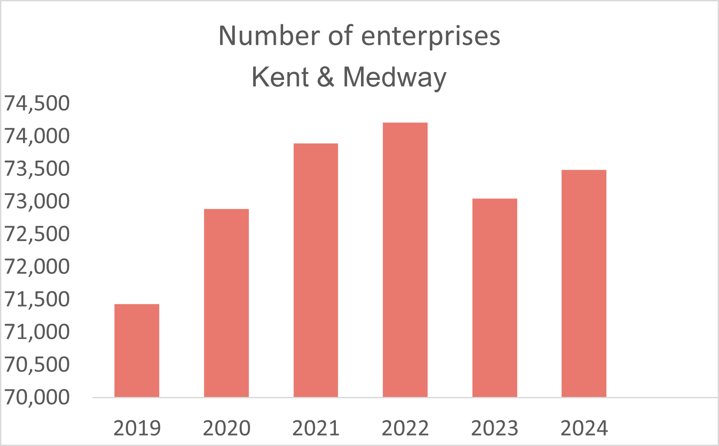
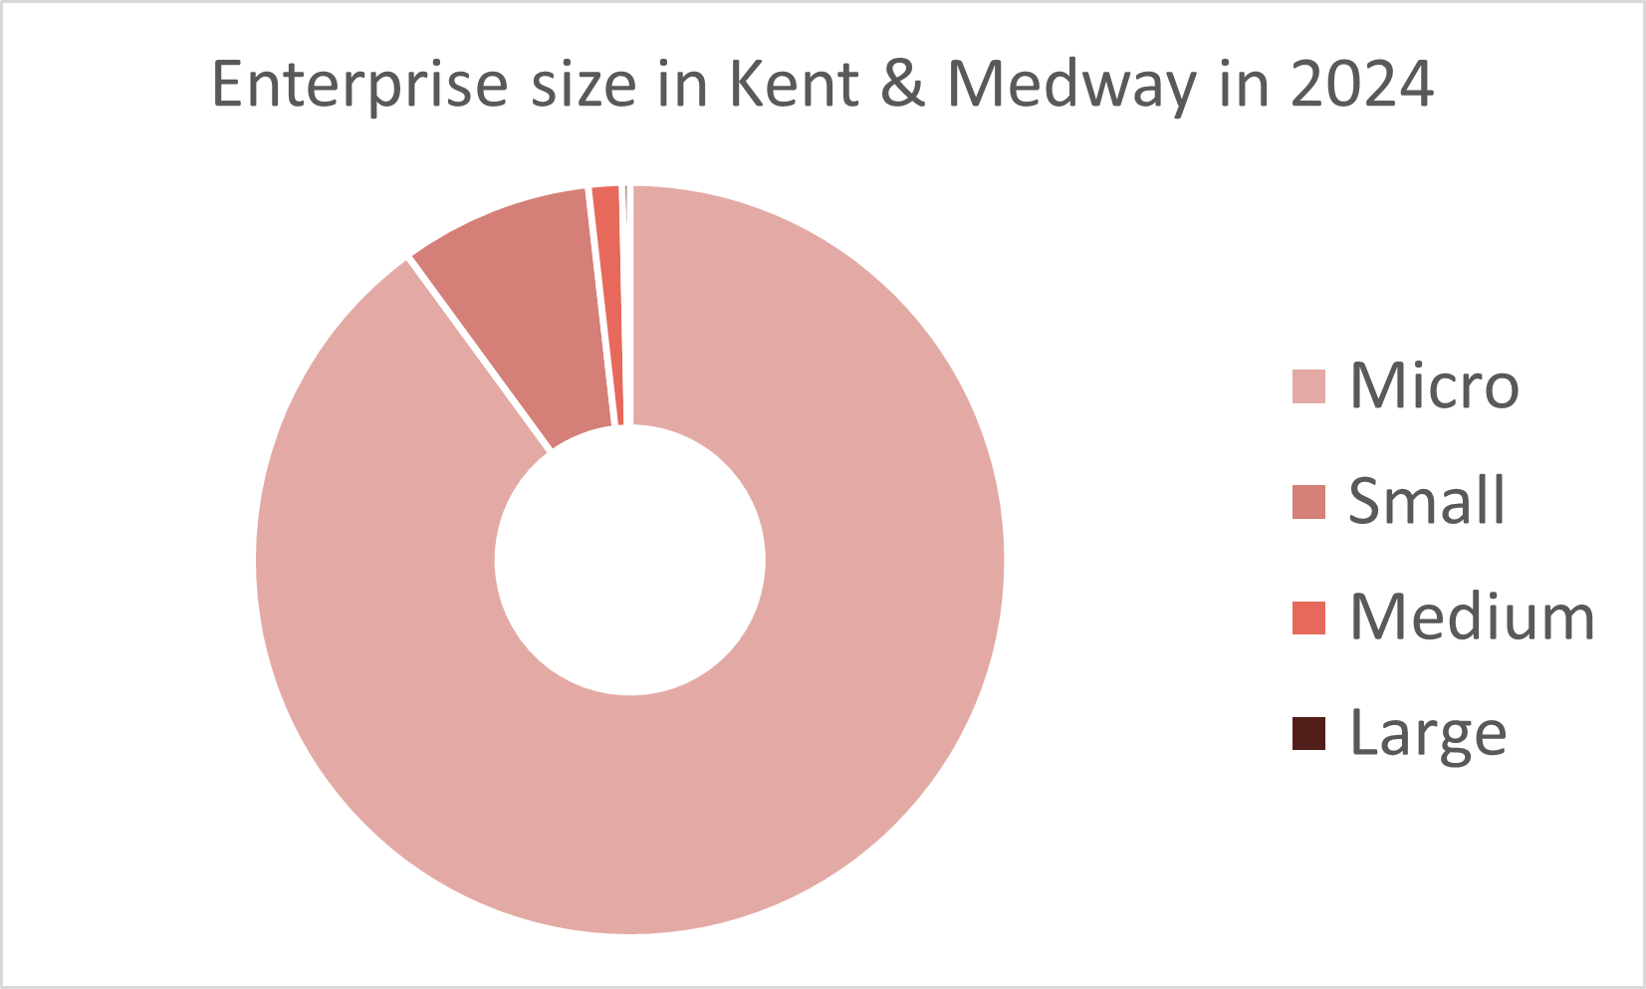
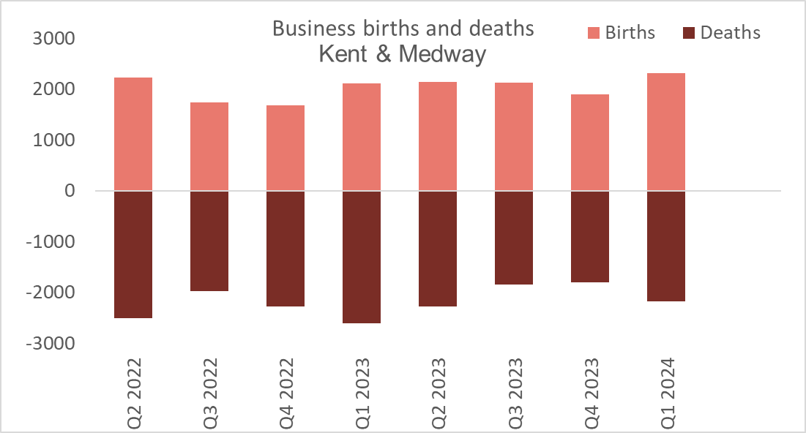
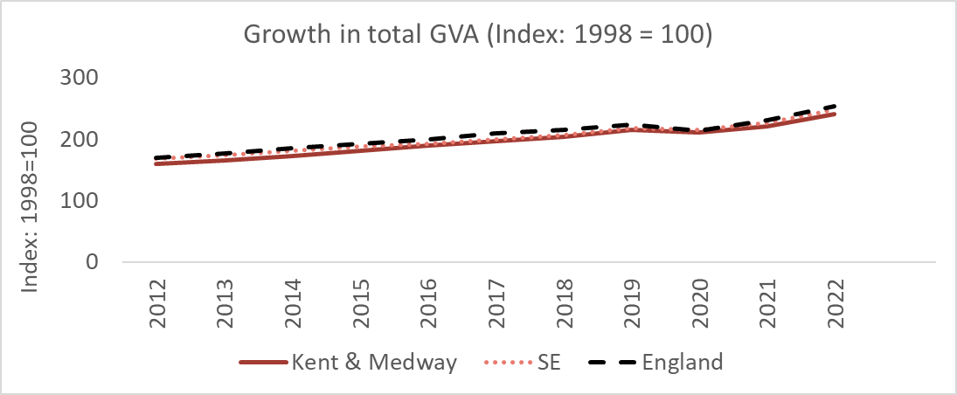
KMEF Ambition: Enable innovative, productive and creative businesses Dashboard of Economic Indicators
Number of enterprises in 2024 | 73,485
1-year change | +440
1 year % change | +0.6%
5 year change | +2,050
5-year % change | +2.9%
Total Value of Exports (£m)
Kent & Medway
2021 | £3,526
2022 | £3,825
Source: ONS UK Business Counts
Regional Trade in Goods (ITL3 level)
Source: HMRC
Enterprise size | Number | Percentage
Micro | 66,100 | 90.0%
Small | 6,080 | 8.3%
Medium | 1,065 | 1.4%
Large | 240 | 0.3%
Business Births and Deaths | Births | Deaths
Kent & Medway
2022 Q2 | 2225 | -2500
2024 Q1 | 2115 | -2180
Source: ONS
Source: ONS UK Business Counts
GVA
Kent & Medway | 2022
Total GVA (£m) | £50,691
GVA per head | £27,022
Source: ONS

Slide 4
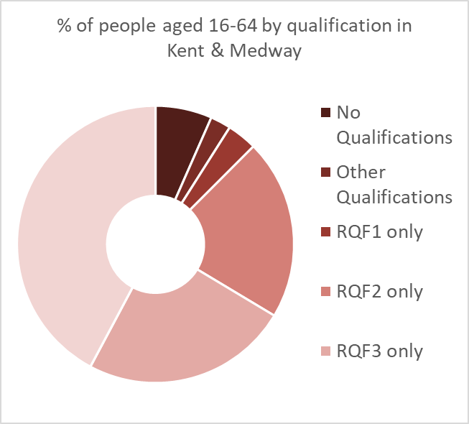
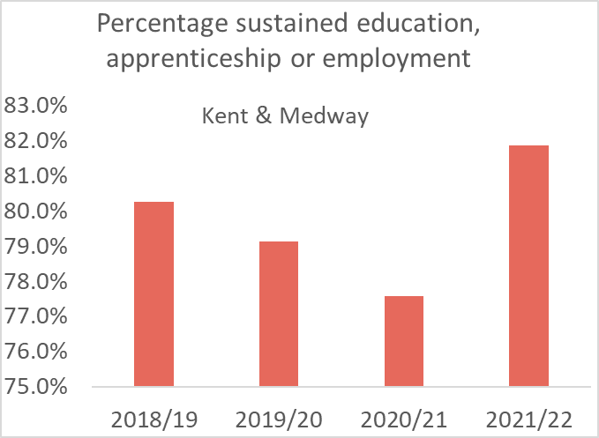
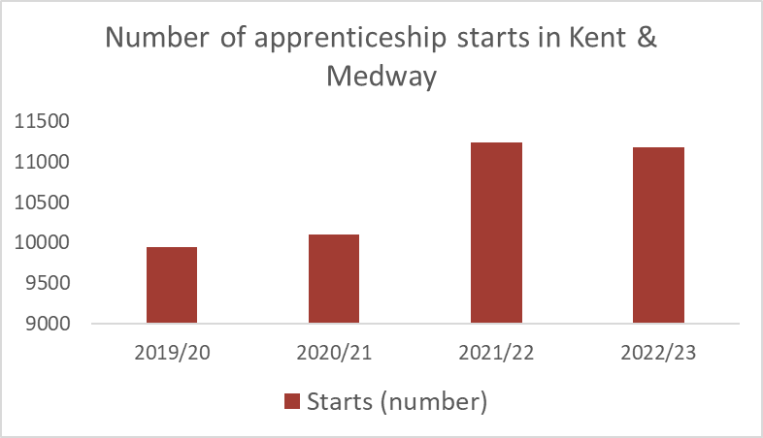
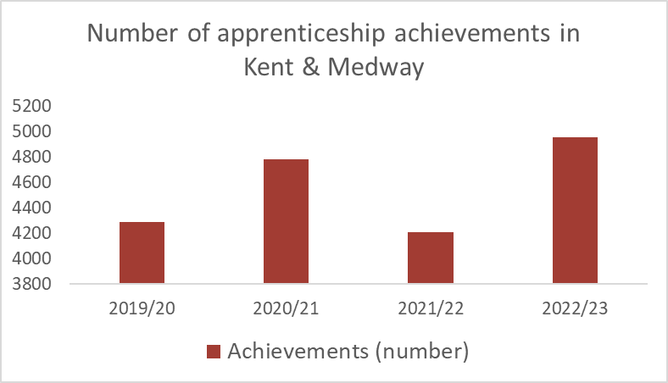
KMEF Ambition: Widening opportunities and unlocking talent Dashboard of Economic Indicators
Qualifications of population aged 16-64
(RQF = Regulated Qualifications Framework)
Kent & Medway | Jan-Dec 2023
No Qualifications | 6.6%
Other Qualifications | 2.4%
RQF1 only | 3.5%
RQF2 only | 21.1%
RQF3 only | 24.2%
RQF4+ | 42.2%
16-18 destination measures
Kent & Medway Percentage | 2020/21 | 2021/22
Sustained education, apprenticeship or employment | 77.6% | 81.9%
Education | 46.5% | 47.9%
Sustained employment destination | 25.5% | 27.5%
Apprenticeship | 5.6% | 6.4%
Education or employment not sustained | 17.0% | 13.2%
Source: Annual Population Survey
Source: Department for Education
Kent & Medway apprenticeship starts | 19/20 | 20/21 | 21/22 | 22/23
Starts (number) | 9,950 | 10,100 | 11,240 | 11,180
Starts (per 10,000 pop) | 54.0 | 54.6 | 60.5 | 59.6
Qualifications of population aged 16 and above who are economically active (excluding full-time students)
Kent & Medway | In employment | % of all in employment | Unemployed | % of all unemployed
Total | 841,098 | 100% | 39,905 | 100%
No qualifications | 71,390 | 8.5% | 6,096 | 15.3%
Level 1 and entry level qualifications | 87,331 | 10.4% | 6,396 | 16.0%
Level 2 qualifications | 126,789 | 15.1% | 7,474 | 18.7%
Apprenticeship | 43,044 | 5.1% | 1,706 | 4.3%
Level 3 qualifications | 177,972 | 21.2% | 6,911 | 17.3%
Level 4 qualifications or above | 317,263 | 37.7% | 10,388 | 26.0%
Other qualifications | 17,309 | 2.1% | 934 | 2.3%
Source: Department for Education
Kent & Medway apprenticeship achievements | 19/20 | 20/21 | 21/22 | 22/23
Achievements (number) | 4,290 | 4,780 | 4,210 | 4,960
Achievements (per 10,000 pop) | 23.3 | 25.9 | 22.7 | 26.4
Source: Department for Education
Source: Annual Population Survey

Slide 5
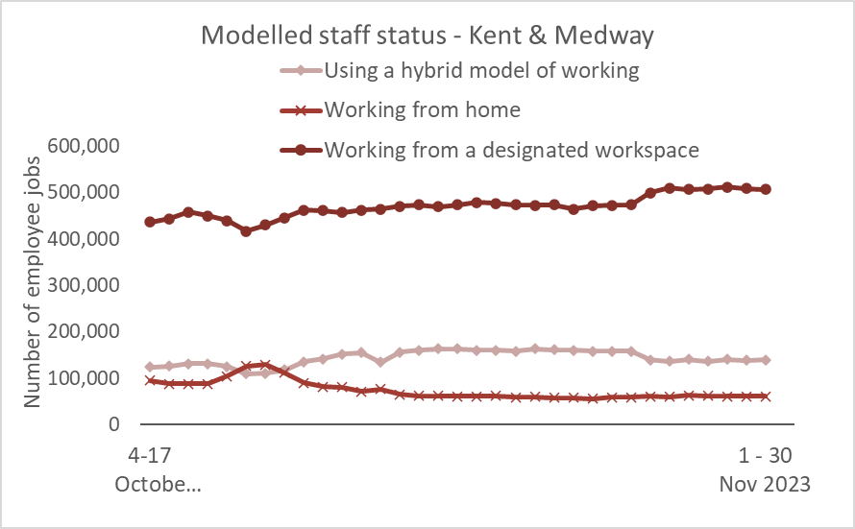
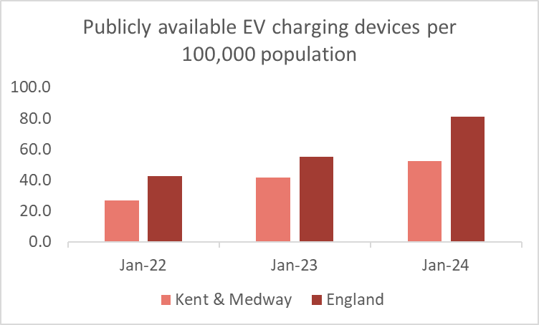
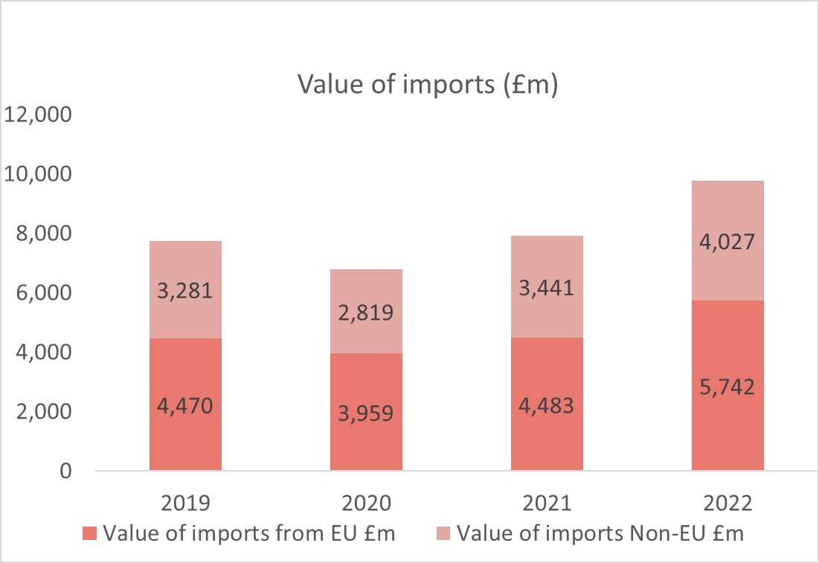
KMEF Ambition: Secure resilient infrastructure for planned, sustainable growth Dashboard of Economic Indicators
Broad band availability | % Superfast broadband availability | % Ultrafast broadband availability | % Full Fibre broadband availability
2020 | 93.9% | 43.9% | 7.8%
2021 | 93.9% | 48.8% | 13.4%
2022 | 95.2% | 68.6% | 44.6%
2023 | 95.6% | 70.1% | 49.2%
Modelled staff Status | Hybrid working | Working from home | Working at workspace
Kent & Medway
Nov 2023
Source: OFCOM - Connected Nations
EV charging | Kent & Medway | England
Jan 2022 | 26.6 | 42.3
Jan 2023 | 41.7 | 55.1
Jan 2024 | 52.5 | 81.2
Kent & Medway Dwelling Stock | 2023 | 5 year change | 5 year % change
Kent & Medway | 828,134 | +41,300 | +5.4%
South East | 4,109,710 | +205,747 | +5.4%
England | 25,396,447 | +1,182,970 | +5%
Source: DFT
Total Value of Imports (£m)
Kent & Medway
2021 | £7,924
2022 | £9,769
Regional Trade in Goods (ITL3 level)​
Source: HMRC
Source: DLUHC Table LT 125

Slide 6
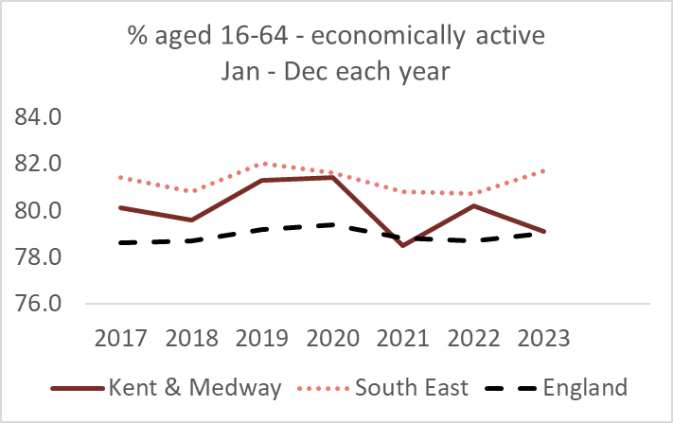
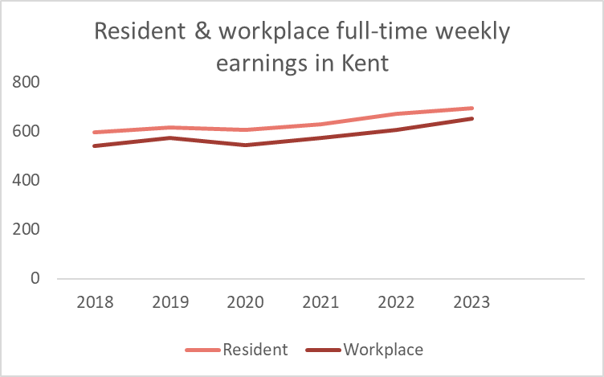
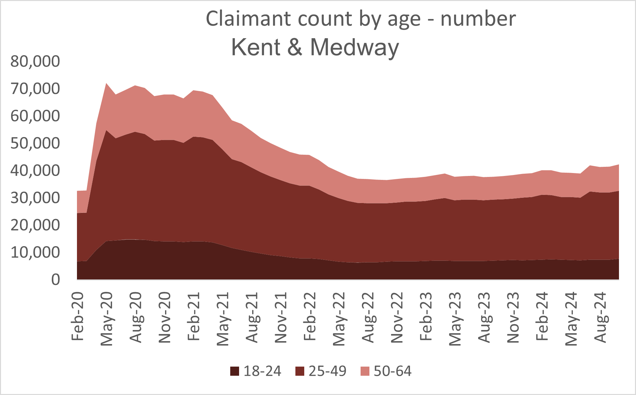
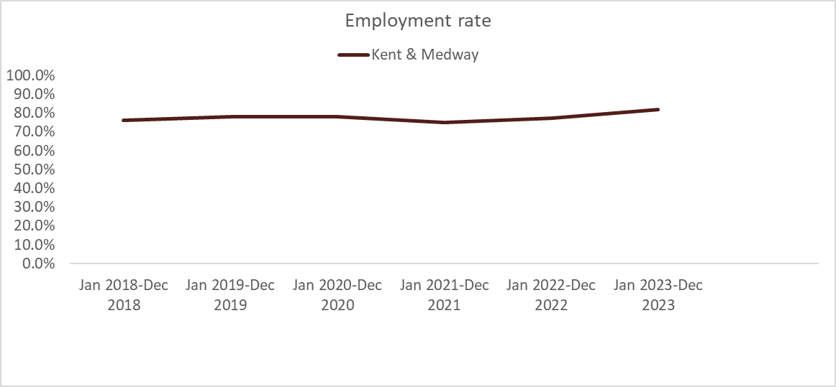
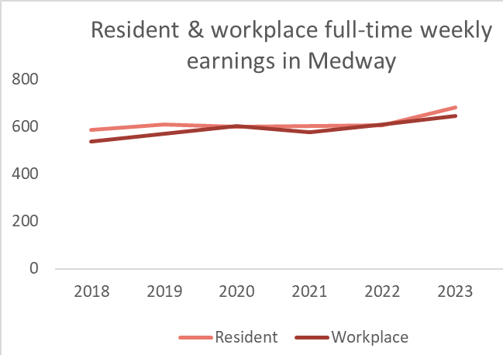
KMEF Ambition: Place economic opportunity at the centre of community wellbeing and prosperity Dashboard of Economic Indicators
Economic Activity (aged 16-64)
Kent & Medway | 2023
% Economically active | 79.1%
% Economically inactive | 20.9%
Earnings Kent | Resident | Workplace
Full-time weekly earnings 2023 | 696.3 | 651.6
1-year change (£ per week) | 25.5 | 46.6
1 year % change | +3.8% | +7.7%
5 year change (£ per week) | 98 | 110.6
5-year % change | +16.4% | +20.4%
Source: ONS Annual Population Survey
Source: ASHE ONS
Claimant Count Unemployment by age |  |  | Kent and Medway
 | Oct 2024 | % Rate | % of all claimants
18-24 | 7,810 | 5.6% | 18.4%
25-49 | 24,870 | 4.3% | 58.6%
50-64 | 9,650 | 2.6% | 22.8%
Employment Rate | Jan 2023 – Dec 2023
Kent | 81.5%
Medway | 84.1%
Kent & Medway | 81.9%
South East | 86.1%
Great Britain | 86.3%
Source: ONS Claimant Count
Earnings Medway | Resident | Workplace
Full-time weekly earnings 2023 | 683.4 | 646.5
1-year change (£ per week) | 78.1 | 35.5
1 year % change | +12.9% | +5.8%
5 year change (£ per week) | 94.9 | 109.9
5-year % change | +16.1% | +20.5%
Source: ASHE ONS
Source: ONS Annual Population Survey

Slide 7
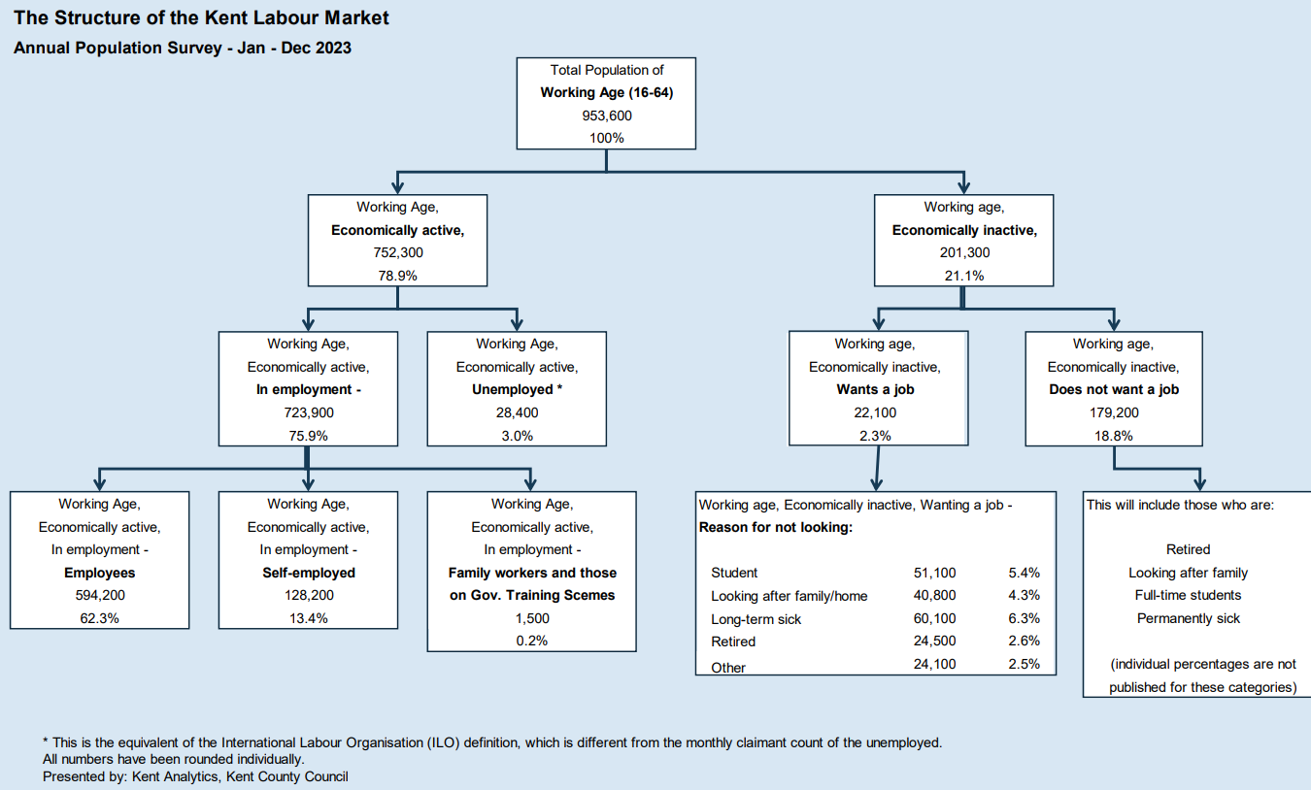
Source: ASHE ONS
Source: ONS Annual Population Survey

Slide 8
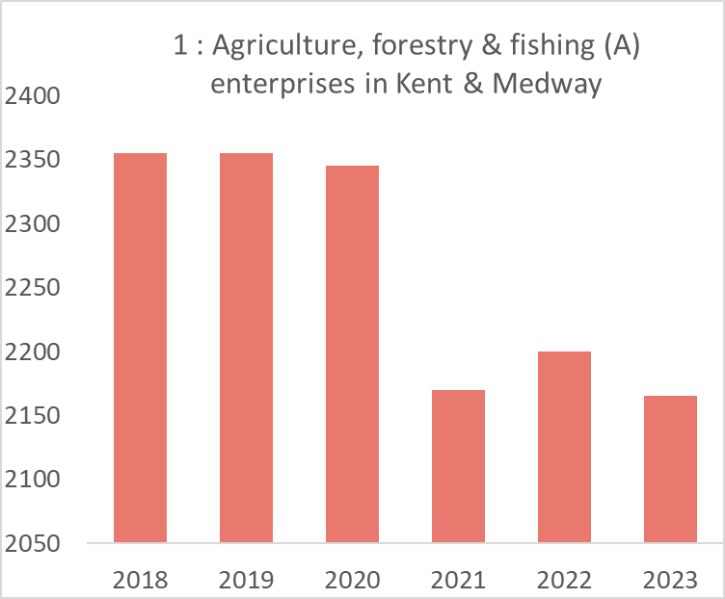
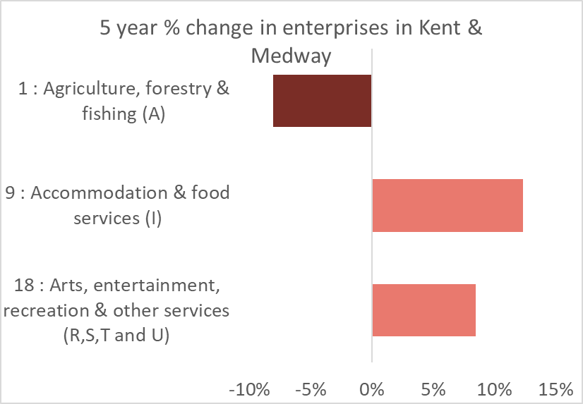
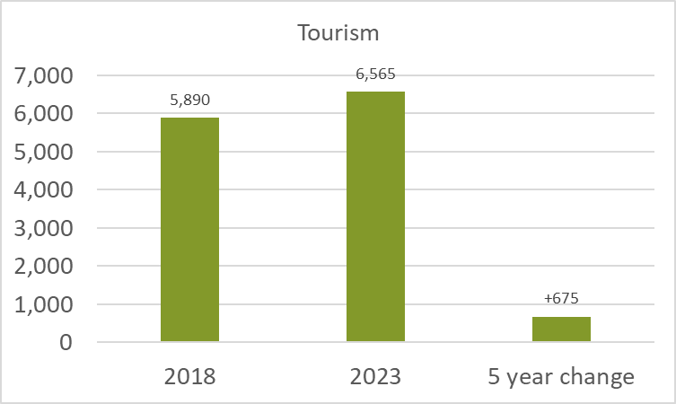
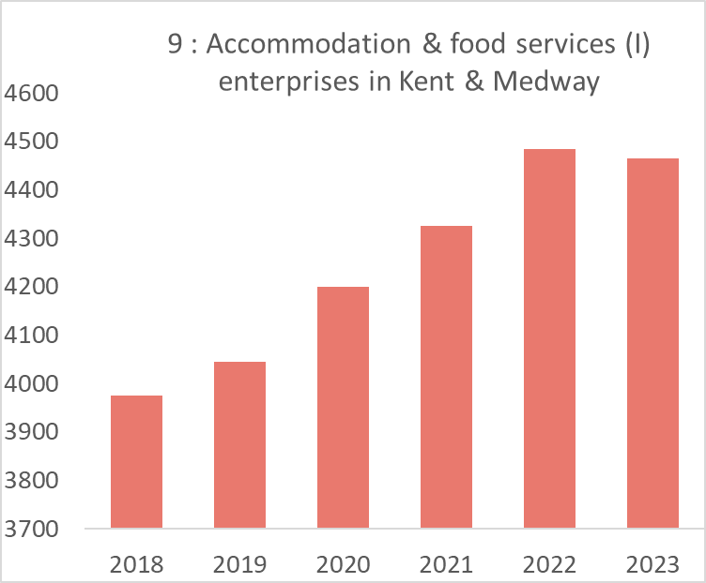
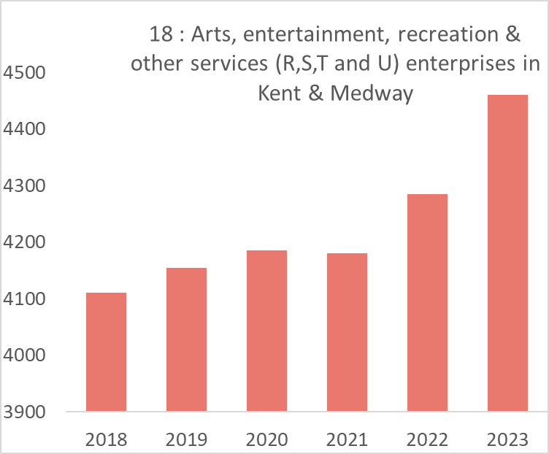
KMEF Ambition: Create diverse, distinctive and vibrant places Dashboard of Economic Indicators
Enterprise by Industry
5 year % change in enterprises in Kent & Medway
 | 2018 | 2023 | % of all enterprises 2023 | 5 year change | 5 year % change
Agriculture, forestry & fishing | 2,355 | 2,165 | 3.0% | -190 | -8.1%
Accommodation & food services | 3,975 | 4,465 | 6.1% | +490 | +12.3%
Arts, entertainment, recreation & other services | 4,110 | 4,460 | 6.1% | +350 | +8.5%
Agriculture, forestry & fishing enterprises in Kent & Medway
Year | Number | % of all enterprises
2019 | 2,355 | 3.3%
2020 | 2,345 | 3.2%
2021 | 2,170 | 2.9%
2022 | 2,200 | 3.0%
2023 | 2,165 | 3.0%
Source: UK Business Counts
Source: UK Business Counts
Accommodation & food services enterprises in Kent & Medway
Year | Number | % of all enterprises
2019 | 4,045 | 5.7%
2020 | 4,200 | 5.8%
2021 | 4,325 | 5.9%
2022 | 4,485 | 6.0%
2023 | 4,465 | 6.1%
Source: UK Business Counts
Arts, entertainment, recreation & other services enterprises in Kent & Medway
Year | Number | % of all enterprises
2019 | 4,155 | 5.8%
2020 | 4,185 | 5.7%
2021 | 4,180 | 5.7%
2022 | 4,285 | 5.8%
2023 | 4,460 | 6.1%
Non-standard industries Kent and Medway | 2018 | 2023 | 5 year change
Tourism | 5,890 | 6,565 | +675
Source: UK Business Counts
Source: UK Business Counts

